Slide 1
Wyndor Glass Co.
Produces windows and glass doors
Plant 1 makes aluminum frames and hardware
Plant 2 makes wood frames
Plant 3 produces glass and assembles products

Slide 2
Wyndor Glass Co.
Company introducing two new products
Product 1: 8 ft. glass door with aluminum frame
Product 2: 4 x 6 ft. double-hung, wood-framed window
Problem:
What mix of products would be most profitable?
Notes:
Assuming company could sell as much of either product as could be produced

Slide 3
Wyndor Glass Co.
Data needed
Number of hours of production time available per week in each plant for new products
Production time used in each plant for each batch of each new product
Profit per batch of each new product
Notes:
Products produced in batches of 20

Slide 4
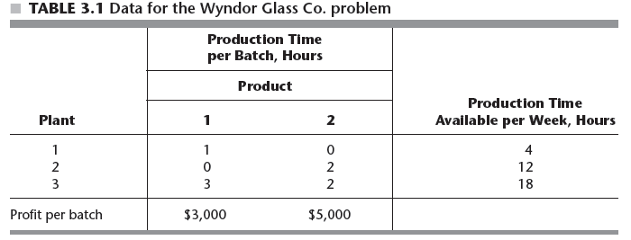
Wyndor Glass Co.

Slide 5
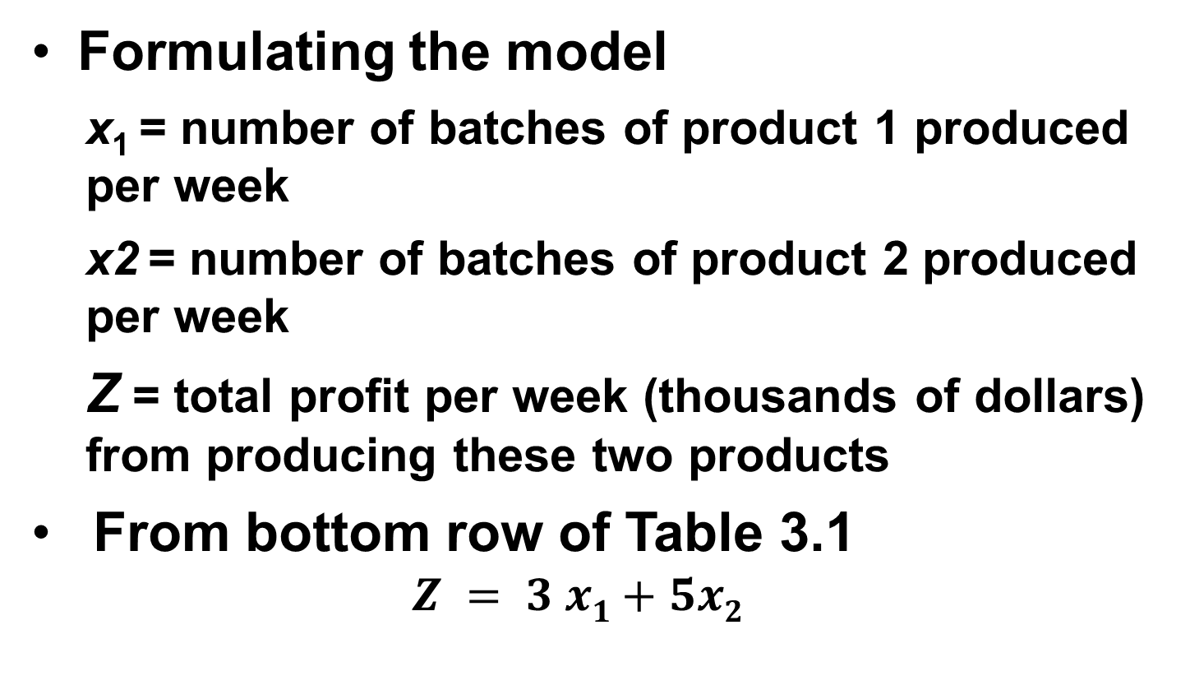
Wyndor Glass Co.
Formulating the model
x₁ = number of batches of product 1 produced per week
x2 = number of batches of product 2 produced per week
Z = total profit per week (thousands of dollars) from producing these two products
From bottom row of Table 3.1
$$Z = 3 x1+5x2$$

Slide 6
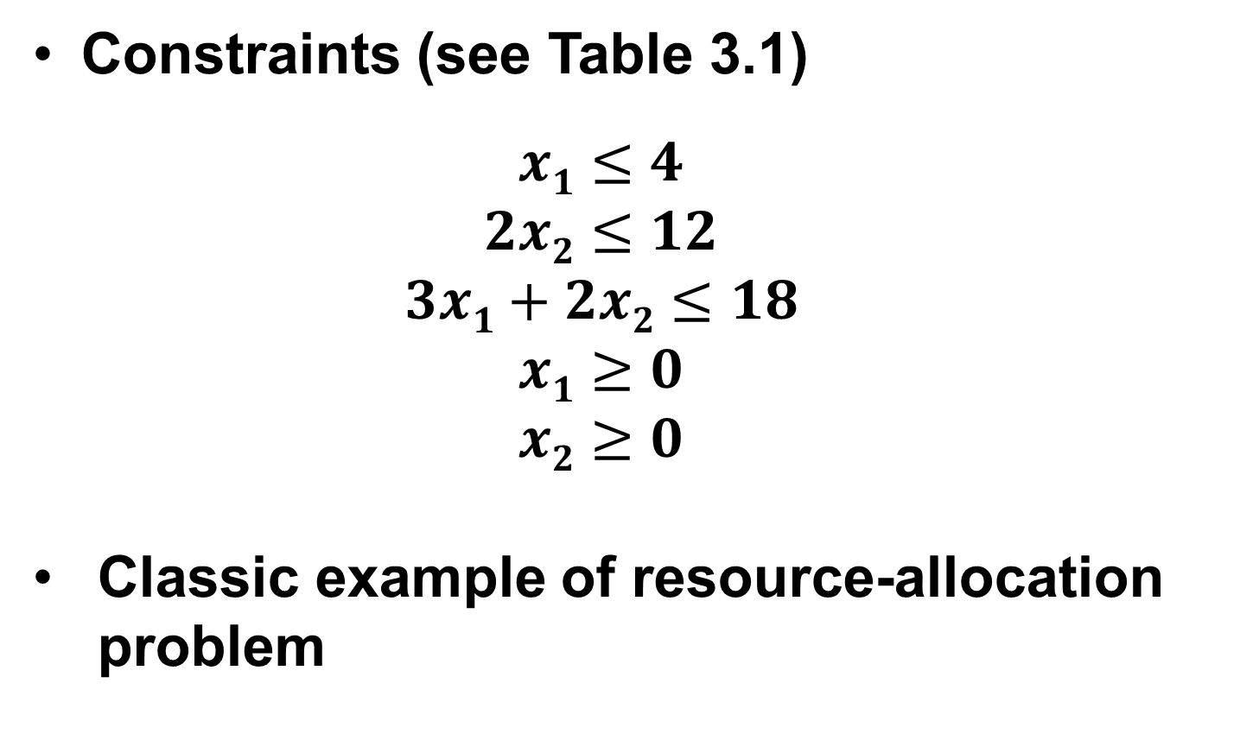
Wyndor Glass Co.
Constraints (see Table 3.1)
$$x1≤4$$
$$2x2≤12$$
$$3x1+2x2≤18$$
$$x1≥0$$
$$x2≥0$$
Classic example of resource-allocation problem
Notes:
Most common type of linear programming problem

